Slide 1
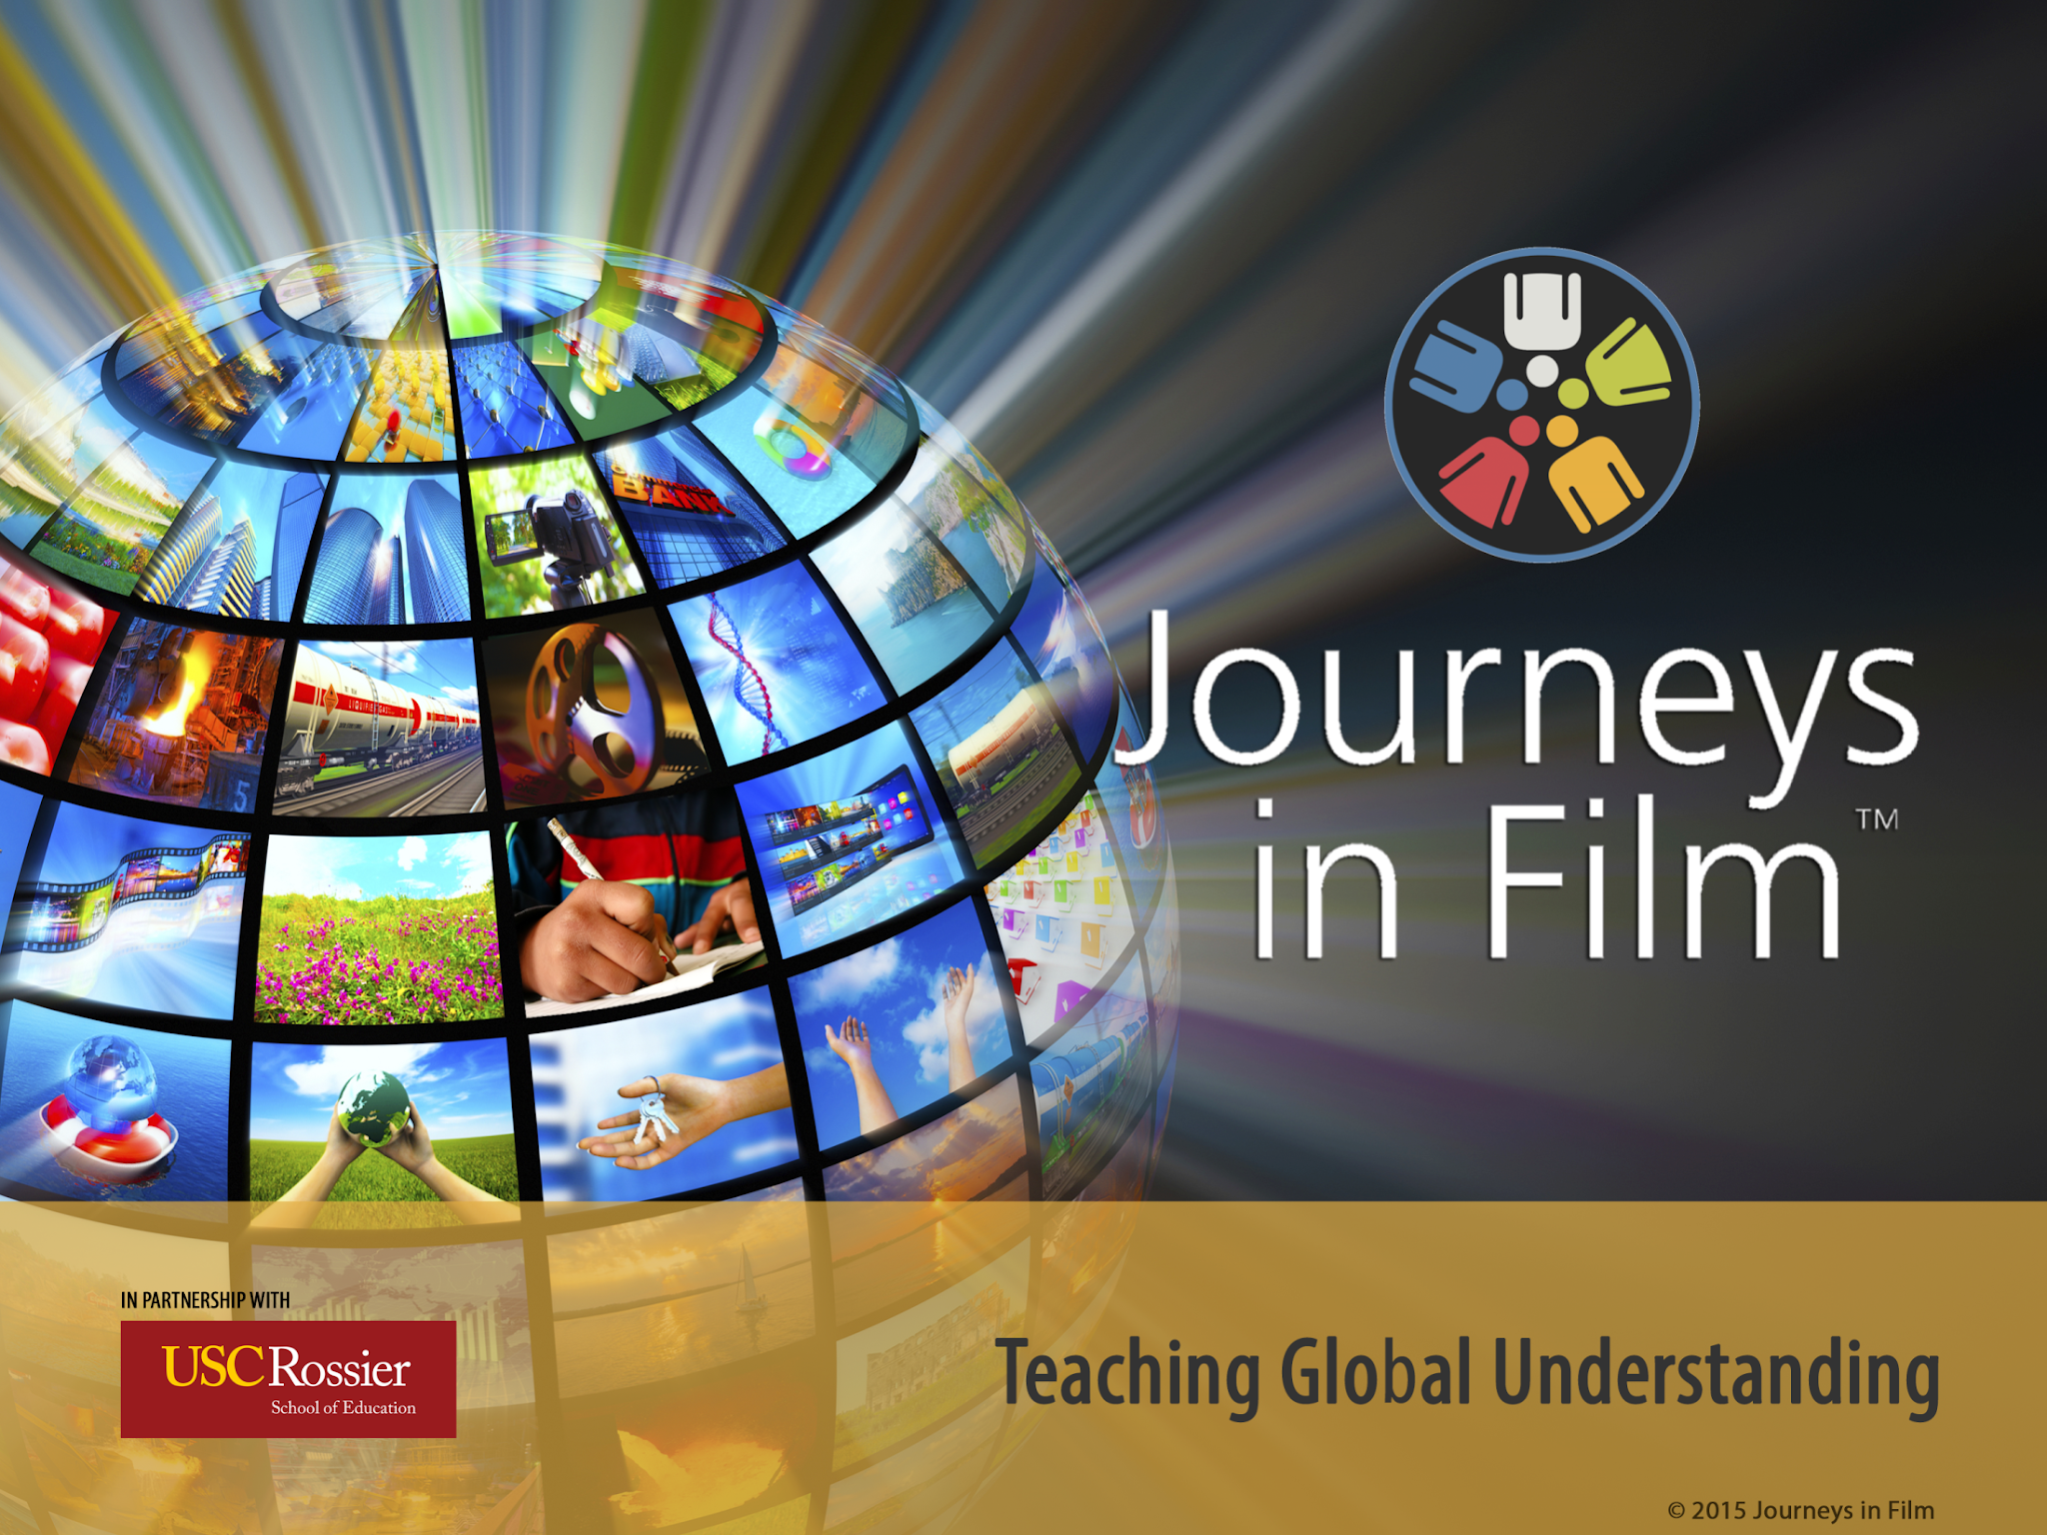
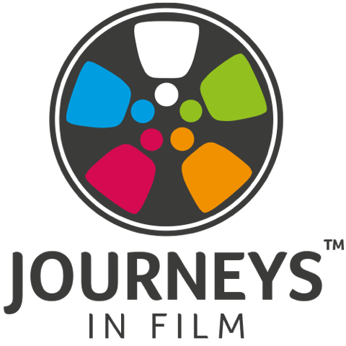
THE ART OF INQUIRY
Notes:
Helpful links
Join Zoom Meeting
https://us06web.zoom.us/j/84028923995?pwd=ukwww5o5AofK1wzAMKapfUfBRfn7K8.1
Icebreaker Question: What is something you are curious about? Or something that you notice that your students are curious about.
Library of Congress Home: https://www.loc.gov/
Handouts:
The Art of Inquiry - Active Listening Handout 11.2.pdf
Using Film For Project Based Learning 11.2.pdf
Windows and Mirrors Handout
4-6pm PT
5-7pm MT
6-8pm CT
7-9pm ET

Slide 2

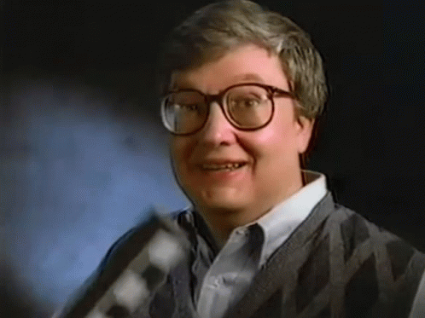
Why Film?
“We are who we are. Where we were born, who we were born as, how we were raised. We are kind of stuck inside that person, and the purpose of civilization and growth is to be able to reach out and empathize a little bit with other people, find out what makes them tick, what they care about. For me, the movies are like a machine that generates empathy…
It helps us to identify with the people who are sharing this journey with us. And that, to me, is the most noble thing that good movies can do and it’s a reason to encourage them and to support them and to go to them.”
- Roger Ebert
Notes:
Windows and Mirrors — Media Audit

Slide 3
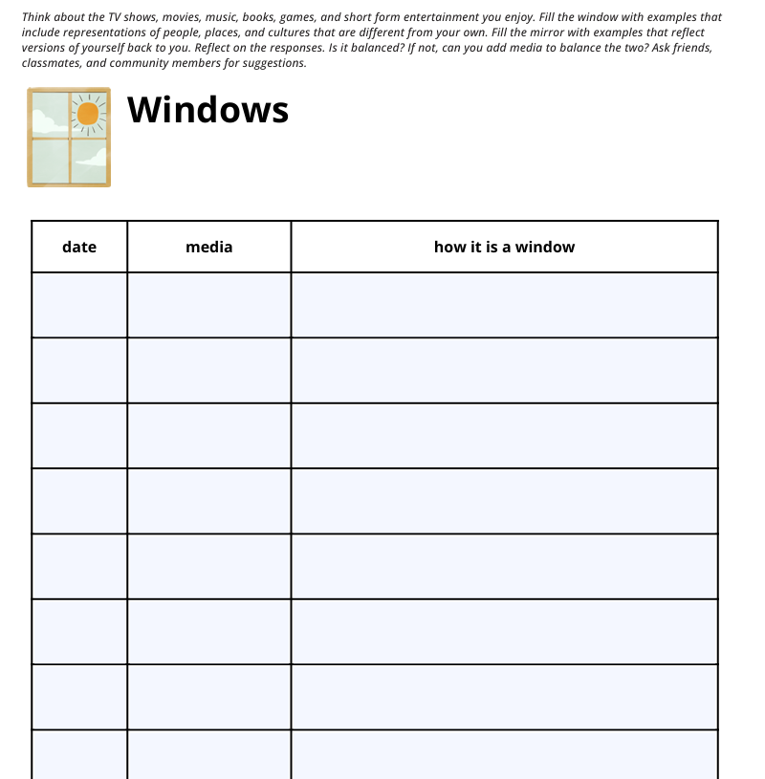

Windows and Mirrors
Representation Matters for Belonging: Conducting a Media Audit
Inspired by Dr. Rudine Sims Bishop's inclusive reading pedagogy
Notes:
HANDOUT #1 - Windows and Mirrors - Media Audit
What is a window? What is a mirror? What windows you provide for your learners? What mirrors do you provide? How can you improve and build belonging? Conducting a Media Audit of your classroom materials can help you see where learners will feel seen and help you identify media to add or replace as you plan. Encouraging learners to participate in a media audit or a media “looking” exercise can help them identify media that helps them feel better about themselves. Understanding others and seeing oneself reflected in media can help build belonging.

Slide 4
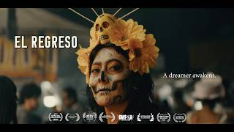
El Regreso: A Dreamer Awakens
"El Regreso is a reminder that no matter how far we travel, our roots continue to shape our wings."
— Samantha Ramirez-Herrera, Filmmaker

Slide 5
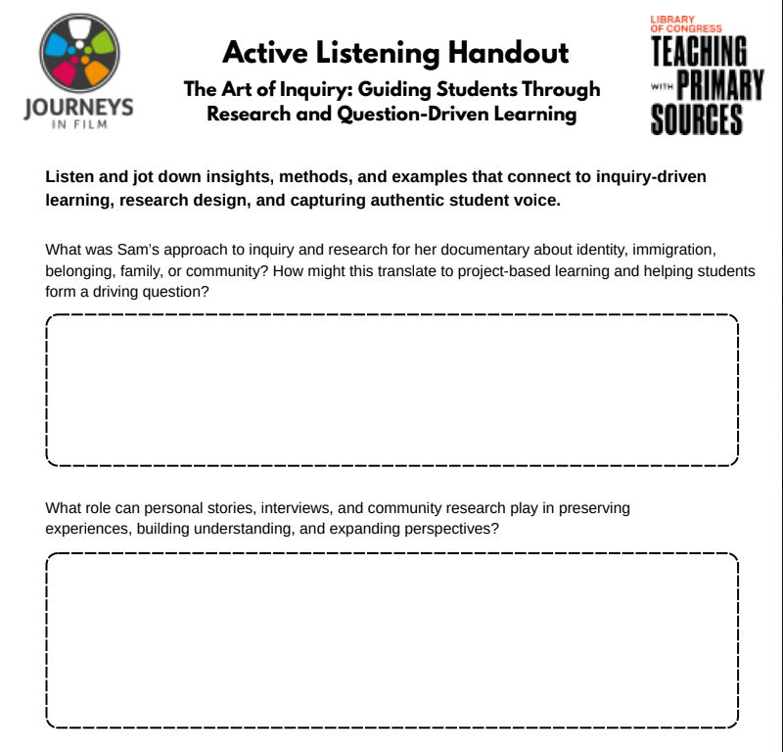
El Regreso Active Listening Handout
Notes:
HANDOUT #2 Active Listening Handout

Slide 6
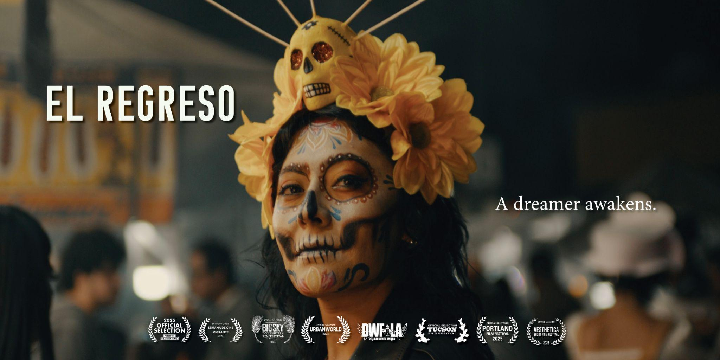
Inquiry and the Filmmaking Process
How did Sam approach this film?
What about Sam’s process piqued your curiosity, made you want to engage in inquiry and learn more?

Slide 7
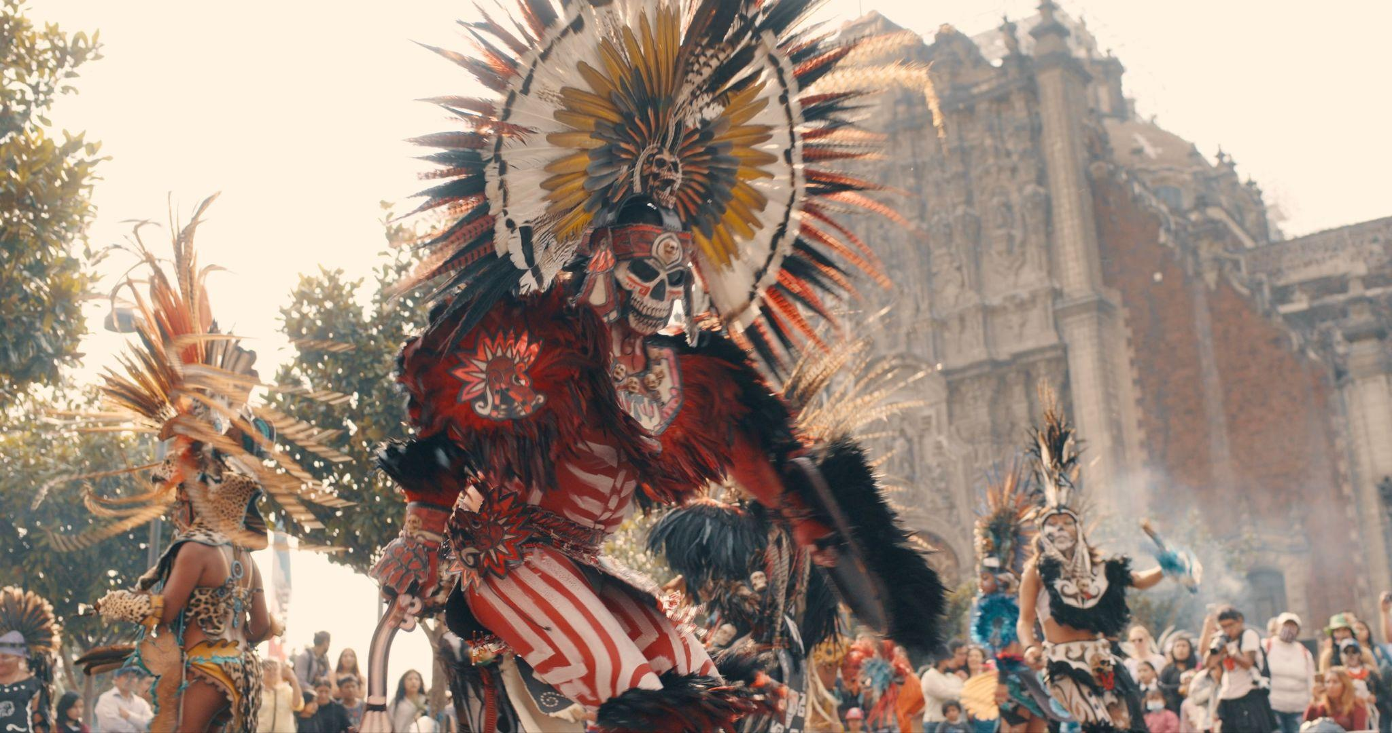
Curiosity, Research, and Empathy
What inquiry process did Sam use that could inspire your students?
What is the relationship between inquiry/curiosity, research (the learning experience) and empathy?
How can empathy and improved understanding build belonging?

Slide 8
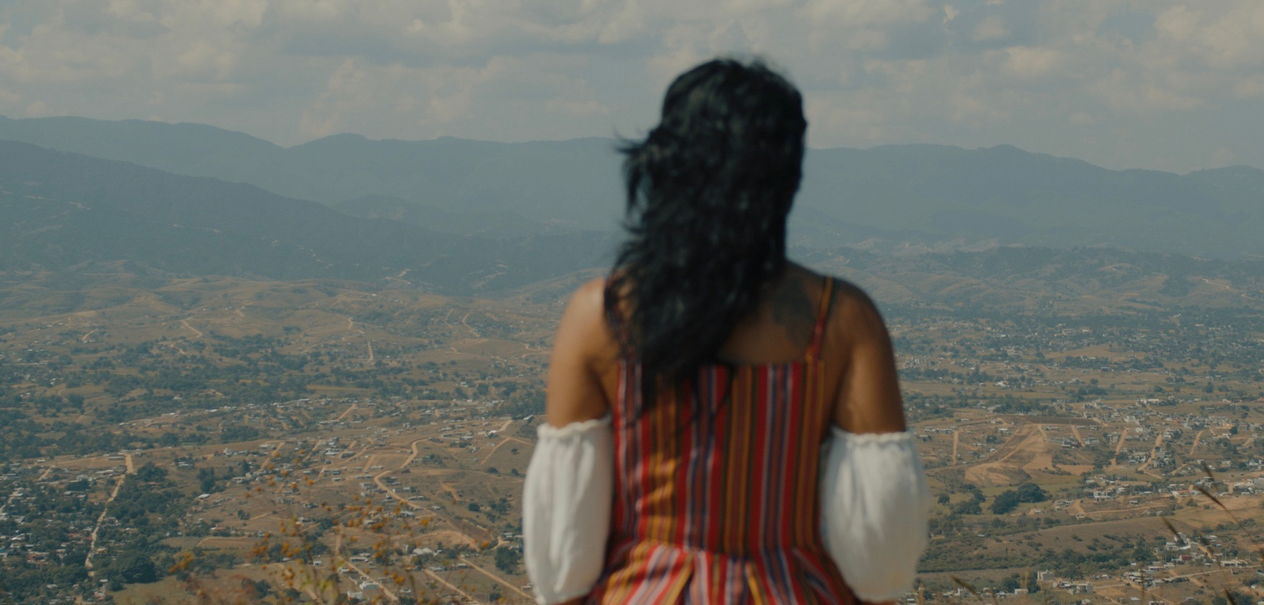
Voice and Empowerment
Sam’s film documents a journey of return in an artistic way that reflects her unique voice and point of view.
How can encouraging students to find their voice be empowering?
How can student research about the world or their own heritage be a source of empowerment and build bridges and belonging in the classroom?
How can Sam’s artistic example encourage students to choose to tell their own stories and produce their own work rather than relying on AI tools? How can this combine with curiosity to inspire them?
Notes:
Frame.io Link to El Regreso: https://f.io/n8Bfbzs7
Password: JIF2026
Expires September 30, 2026

Slide 9
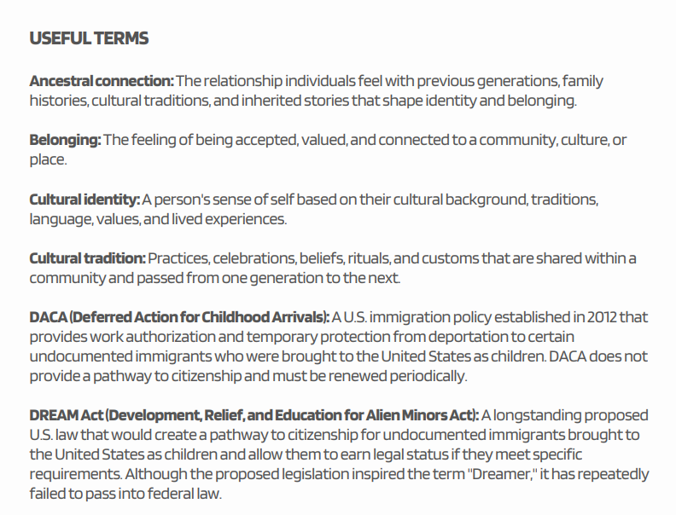
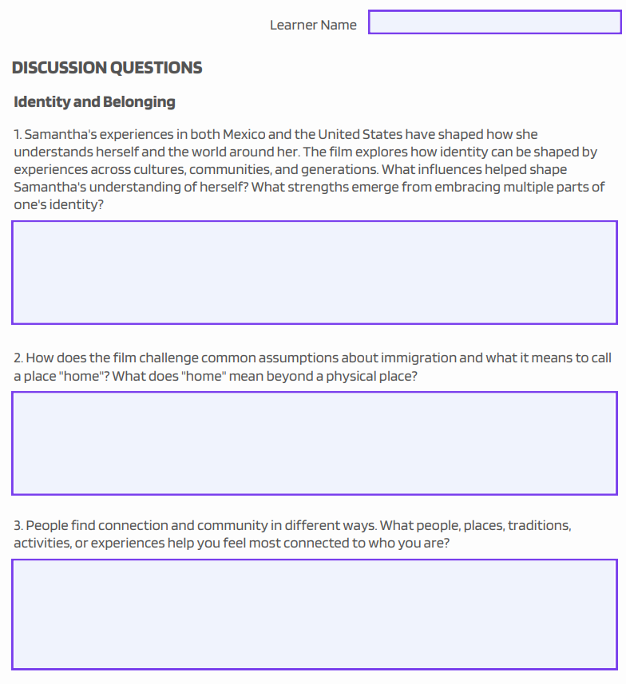
El Regreso Bell Ringer/Mini Discussion Guide
Notes:
Frame.io Link to El Regreso: https://f.io/n8Bfbzs7
Password: JIF2026
Expires September 30, 2026

Slide 10
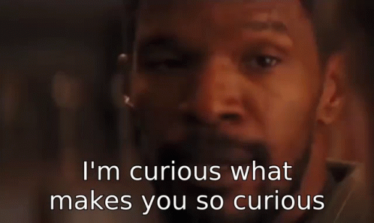
THE ART OF INQUIRY - FOSTERING CURIOSITY
WHAT IS CURIOSITY?
Are the learners you work with curious?
If not, how can you encourage curiosity in your learning space? If they are, what are they curious about?
Filmmakers are innately curious. How can using film in the classroom encourage curiosity in your students?

Slide 11

THE ART OF INQUIRY - FOSTERING CURIOSITY
REFLECT TOGETHER
How has curiosity worked in your life?
What has the value of curiosity been in your life?
When have you felt your curiosity was supported? Can that experience inform your teaching approach?
How has curiosity enriched your life? Complicated your life?
How do you approach the things you are curious about?
Can you share any of those approaches/techniques with your learners?

Slide 12
HOW DOES CURIOSITY BENEFIT STUDENTS
Fostering curiosity in learning spaces and nurturing learner curiosity has many benefits. Curiosity can:
Increase cognitive flexibility
Encourage innovation and learner autonomy
Lead to interdisciplinary thinking/learning
Reduce anxiety and foster joyful learning experiences, which can bolster belonging
Build student interest in research including the process of finding primary sources, understanding them and connecting them to current events or their own lives
Notes:
DACA is a good example of this.

Slide 13
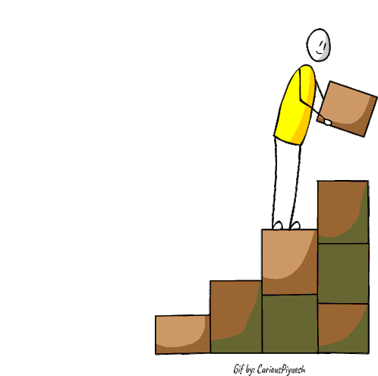
CURIOSITY OVERLAPS WITH PBL APPROACHES
Curiosity-led learning mirrors project-based learning techniques, both:
Start with a central question/point of curiosity
Move from a question to discovery and research to explore the curiosity
Involve collection of information/data/examples/primary sources or the creation of an archive that responds to the starting question
Should involve reflection and/or application as part of the process or approach

Slide 14
"Curiosity is the beginning of inquiry, and inquiry is the pathway to belonging."
Films/Stories spark curiosity.
Curiosity leads to questions.
Questions lead to research.
Research builds understanding and empathy.
Understanding helps students find their voice.
Voice and shared stories foster belonging.
Notes:
Image from Library of Congress

Slide 15
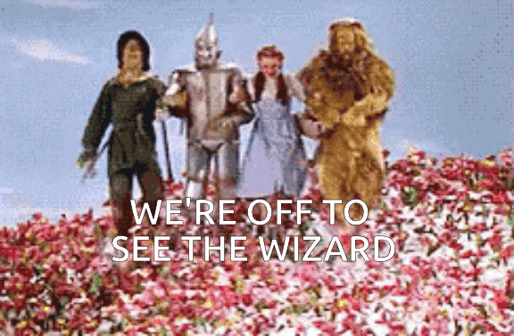
Let’s Get Curious!
Notes:
Hershawna

Slide 16
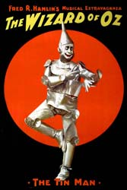
Essential Understandings
Select a high-quality, relevant film
Identify the essential understandings of key themes or subject matter that the film explores (e.g. Civic Action, Environment, SEL, History, Equity)
Use the film’s themes to anchor cross-curricular learning goals
(e.g. connecting social studies standards with research and media literacy skills).
Have students locate/find/discover primary sources that deepen understanding of a key theme raised in the film
(photos, articles, oral histories, Library of Congress archives)
Film: The Wizard of Oz
Essential Understandings: Central themes explored include belonging, self-discovery, friendship, and home/community. Subject areas can include History, SEL, Media Literacy, Music
Through its music, imagery, and historical context, The Wizard of Oz reminds us that we often already hold the courage and belonging we search for, and that community helps us see it.
Chat Question: What other key themes or subject
areas might the film help us to explore?

Slide 17
Driving Question & Inquiry
Encourage learners to pull key takeaways from the film for close analysis
(e.g., community impact, personal narratives, data visuals).
Work with learners to identify an open-ended driving question that connects the film’s central issue to their own world.
Research mapping: What questions emerge? What evidence do learners need next?
Use the Library of Congress archives and other vetted online sources to find documents, maps, or interviews that help learners investigate this question historically or comparatively.
Example Driving Questions:
What does it mean to search for belonging, and how do we know when we’ve found it?
How do friendships and communities help us become our best selves?
What is “home?” (e.g. a place, a feeling, or a relationship)?
How did the challenges of the Dust Bowl shape the story, message, or feeling of the film?
Chat Question: Can you think of any other
possible driving questions?
Notes:
Research mapping is the process of writing down what you already know about a topic, what you’re wondering, what you still need to find out, and possible sources to help find the information you are seeking. It helps you plan your research step-by-step instead of getting overwhelmed.

Slide 18
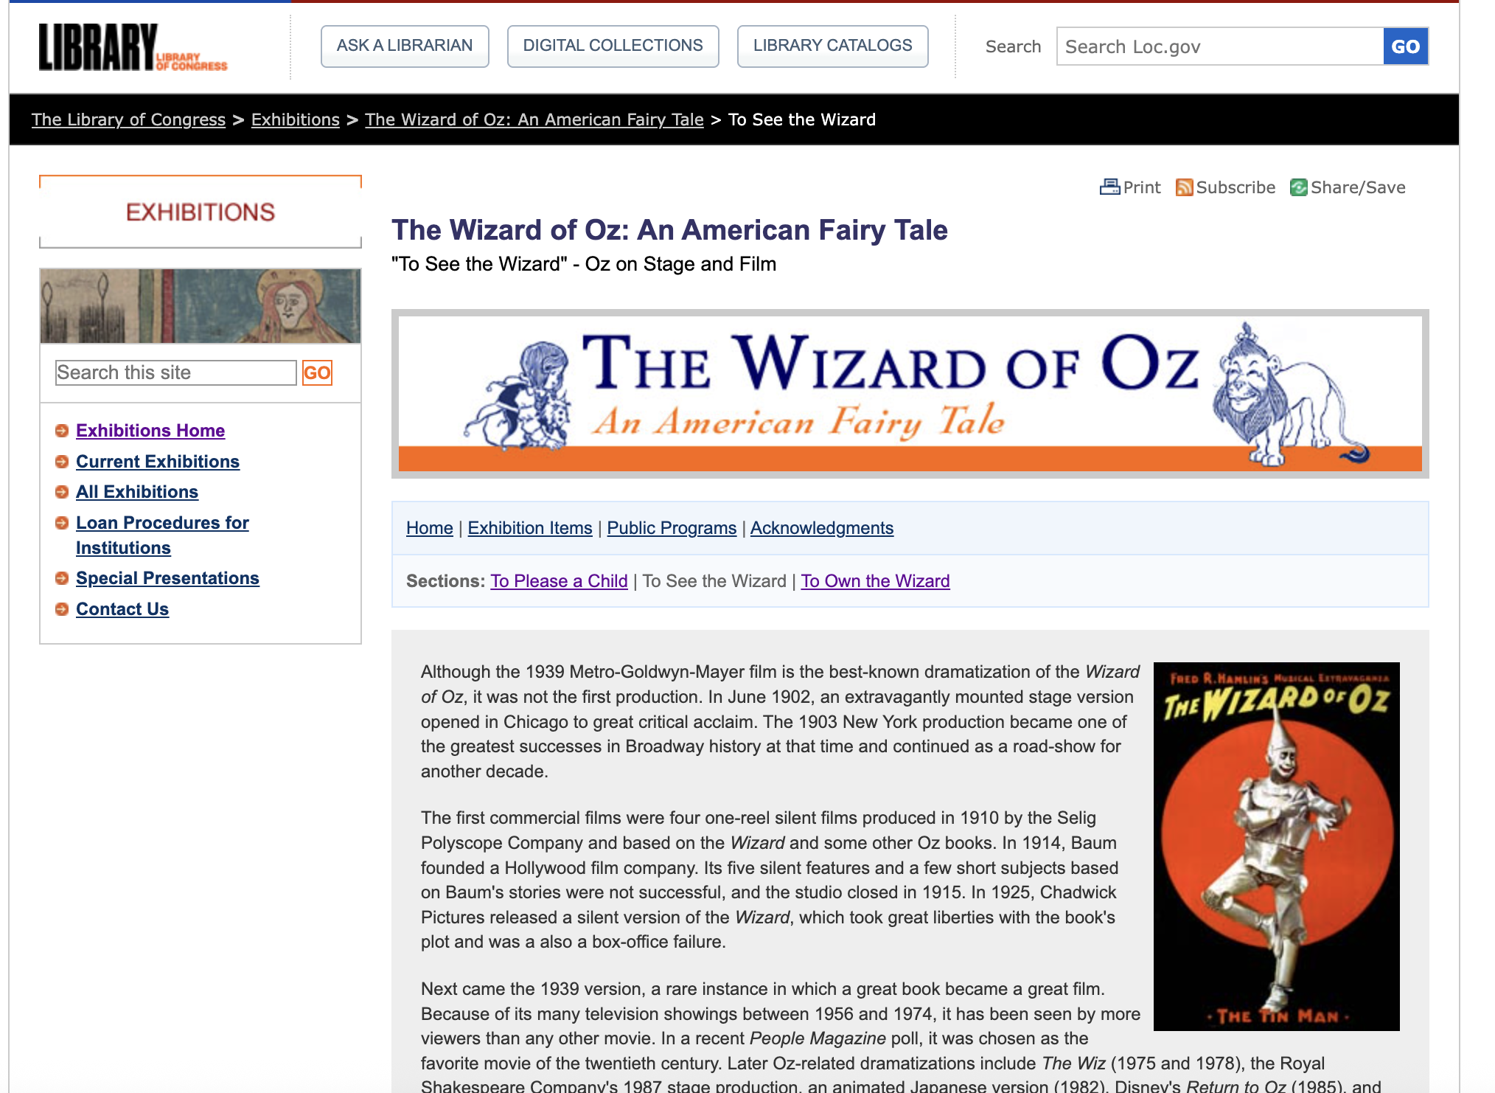
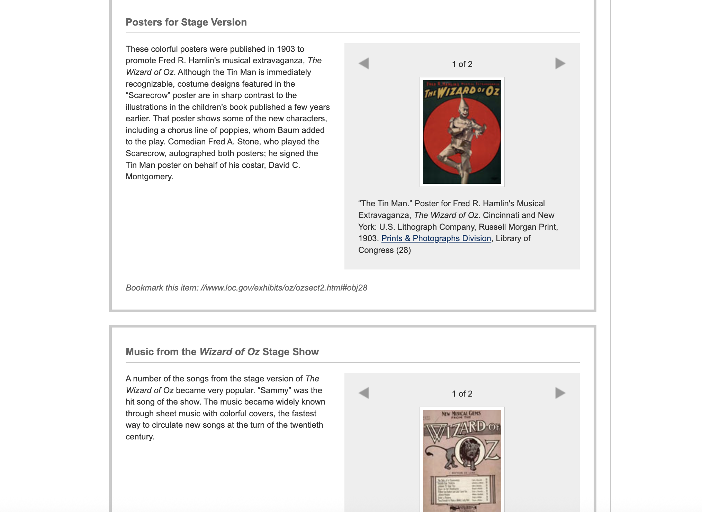
Library of Congress: Wizard of Oz
Notes:
Library of Congress Wizard of Oz: https://www.loc.gov/exhibits/oz/ozsect2.html

Slide 19
Authentic Student Voice & Choice
Films naturally introduce authentic human experiences and social issues.
Students choose a theme, person, or issue from the film that resonates with them and design a project that connects to their personal lives or communities.
The project allows for choice in topics, tools, resources, and presentation formats, which supports diverse interests and learning styles.
Provide opportunities for learners to independently explore LOC digital collections and other archives to support their personal line of inquiry.
Allow learners to brainstorm “real-world” projects that they could create (e.g., a community story map, a service project, a “What is Home?” photo collage or “Community Travel Brochure.”)
Teach learners to cite materials properly, treating them as authentic research evidence.
Project Possibilities:
A personal narrative or digital story exploring what “home” means to them.
A visual art project reimagining the Yellow Brick Road as a journey from challenge to self-trust.
Interview family or community members about times where they discovered their own strengths and create an article, podcast, or other presentation format.
A comparative analysis between The Wizard of Oz and another “journey” story (e.g., Black Panther, Moana, Inside Out, or a cultural folktale).

Slide 20
Reflection & Revision
Learners and educators reflect on learning, quality, and the process of their work. (e.g. “How did the film, your research, and your project expand your view of the issue?”)
Have learners reflect on how primary and secondary sources differ and what they reveal about truth and storytelling.
Encourage fact-checking: Have learners verify that each source used is authentic, cited, and relevant.
Create opportunities where learners give warm/cool feedback and provide learners with time and opportunities to apply improvements to their process and projects
Reflection Prompts:
How did your understanding of courage change during this project?
What sources or stories helped expand your thinking about identity or belonging?
Feedback Prompts:
Warm feedback: What is working well?
Cool feedback: Where does the meaning need more clarity or depth?

Slide 21

Showcase & Share
Learners share their project work beyond the classroom.
Host a public showcase, digital gallery, or schoolwide “Community Inquiry Night” featuring learner-curated projects inspired by the film.
Include annotated researched artifacts or short written analyses with learner exhibits.
Possible Formats:
School or classroom “Storytelling Night” featuring written pieces, art, media, or oral histories.
A digital exhibition titled “There’s No Place Like Home” collecting audio/video storytelling about belonging.
A hallway gallery walk with narrative captions and primary source annotations.
Sharing work with families or community organizations that support identity and cultural storytelling.

Slide 22
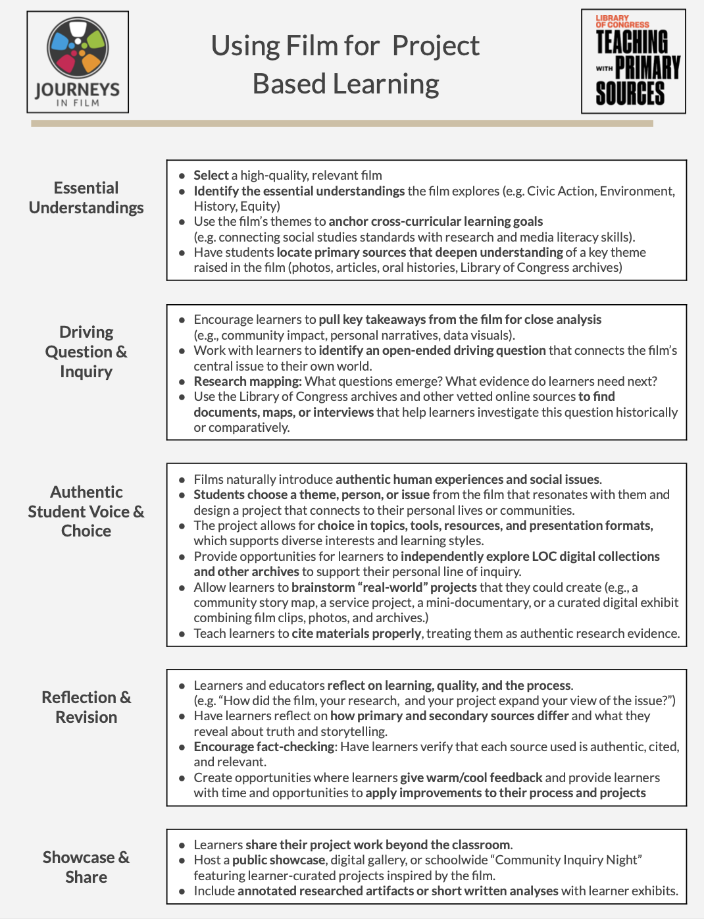
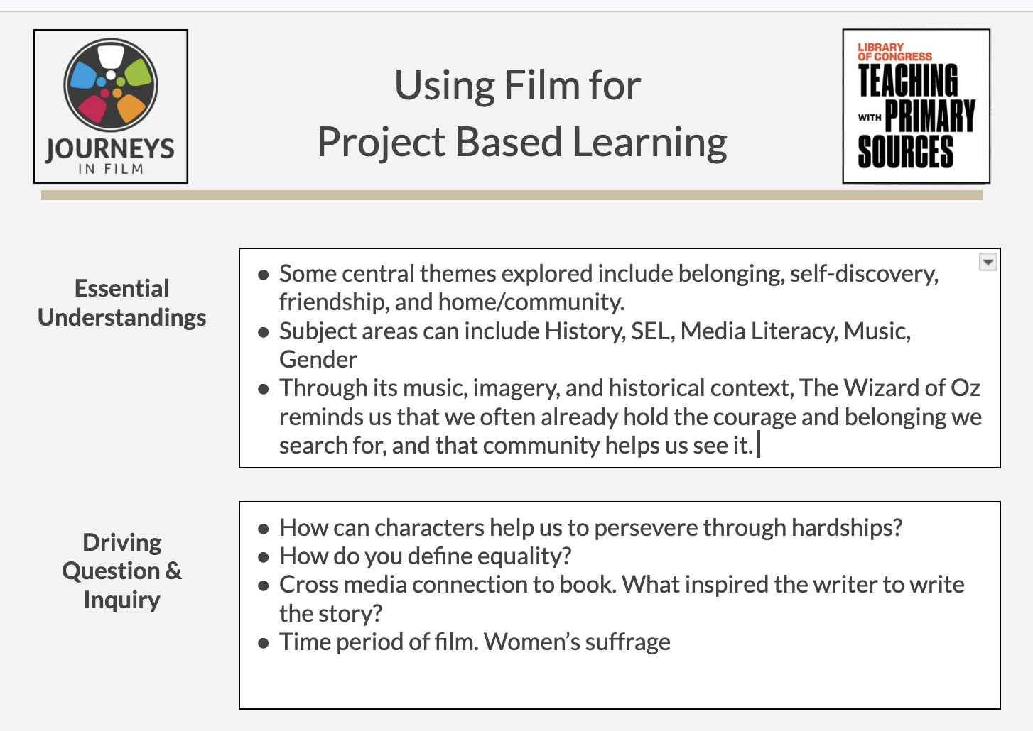
Handout: Using Film for Project Based Learning
Notes:
HANDOUT 3: Using Film for Project Based Learning
HANDOUT 4: Using Film for Project Based Learning_Blank

Slide 23
A Wonder Wall
Before we close, I'd love to hear one "wonder" you're taking with you today.
Complete this sentence in the chat:
I wonder…
Examples:
I wonder whose story my students have never heard.
I wonder what my students are most curious about.
I wonder what primary sources will surprise them.
I wonder how storytelling can help build belonging.
Notes:
Image from Library of Congress

Slide 24
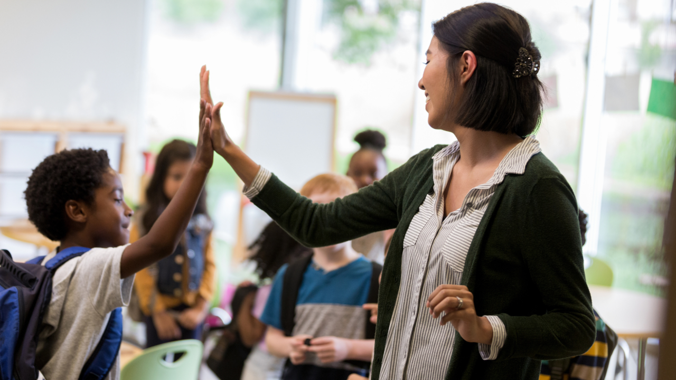
Today’s Driving Question
As you go back into your classrooms…
How will you create opportunities for every student to experience a sense of belonging through inquiry, storytelling, and primary sources?
What stories need to be heard?
Whose voices are missing?
Where might curiosity lead?
Notes:
Image from Library of Congress

Slide 25


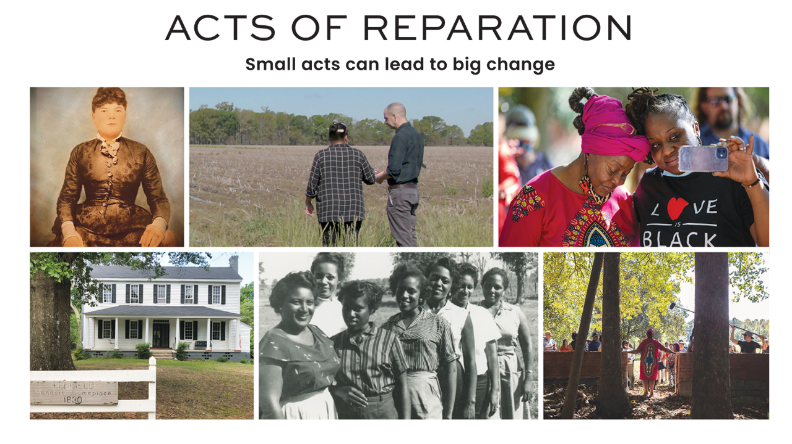

HELPFUL RESOURCES
Journeys in Film’s new resources at a glance.
Acts of Reparation, Sugarcane and other films for primary source learning, research techniques/approaches, deep historical inquiry
Majority Rules, Dark Money and other films for civic learning, civic engagement, and curiosity about elections.
And So It Begins for inquiry around the Philippines, social media influence on elections, and women leaders.
Her Story, Her War: World War II for curiosity around women’s roles, code breaking, and more.
Searching for Amani and The White House Effect for environmental education, and/or interviewing, journalistic inquiry.

Slide 26
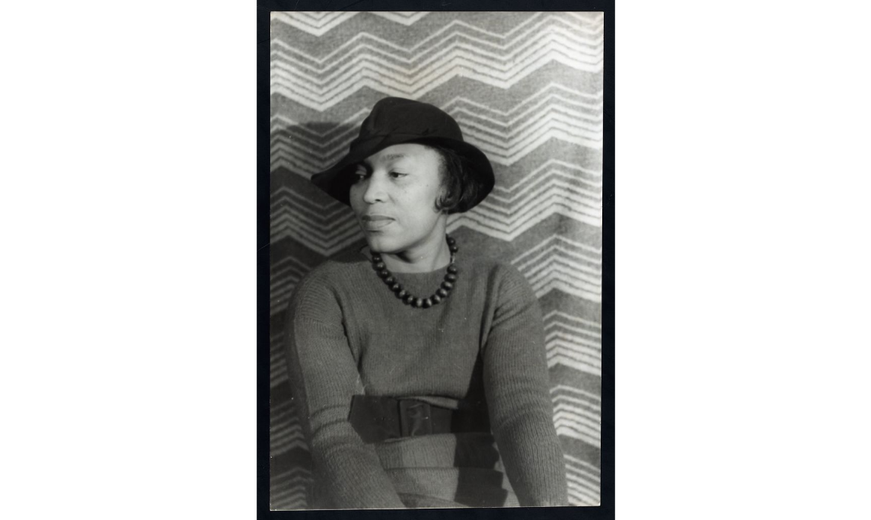
CURIOSITY AND RESEARCH
“Research is formalized curiosity. It is poking and prying with a purpose.”
- Zora Neale Hurston
Notes:
Image from Library of Congress

Slide 27



Upcoming Webinars!
Stories That Connect: Using Film &
Primary Sources To Build Belonging
Remaining Webinars in this Series!
Cultural Products as Historical Narrative
September 22, 2026 4-6 pm PT / 7-9 pm ET
featuring Alicia Reese, Silkroad
possible appearance by Mazz Swift
Uncovering and Amplifying Untold Stories
November 3, 2026 4-6 pm PT / 7-9 pm ET
featuring Selina Lewis Davidson & Macky Alston
Filmmakers, Acts of Reparation
Notes:
Image from Library of Congress

